Slide 1
Celiac Disease
Prediction System
Using Random Forest & Support Vector Machine Classifiers
ML Healthcare Project | May 2026
2,206
14
91.3%
Binary
Patient Records
Features
Best Accuracy
Classification

Slide 2
Dataset Overview
2,206
FEATURES IN THE DATASET
Feature
Type
Description
Total Patient Records (Rows)
Age
Numeric
Patient age (1–35 yrs)
Gender
Categorical
Male / Female
15
Diabetes
Categorical
Presence of diabetes
Diarrhoea
Categorical
Inflammatory / Fatty / Watery
Total Columns — 14 Features + 1 Target
Abdominal
Categorical
Abdominal pain (yes/no)
Short_Stature
Categorical
PSS / DSS / Variant
83.5%
Sticky_Stool
Categorical
Sticky stool (yes/no)
Positive Cases (Celiac Diagnosed)
Weight_loss
Categorical
Weight loss (yes/no)
IgA / IgG / IgM
Numeric
Immunoglobulin A, G, M levels
418
Marsh
Categorical
Biopsy grade (0, 1, 2, 3a, 3b, 3c)
cd_type
Categorical
Subtype (typical/silent/latent…)
Missing values in Diabetes Type → Dropped
Diabetes Type
Categorical
418 missing → dropped
Target: Disease_Diagnose (yes / no)

Slide 3
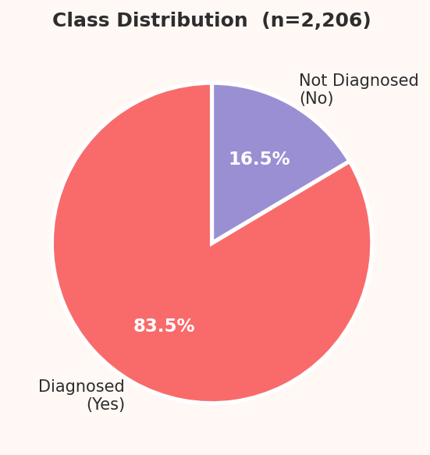
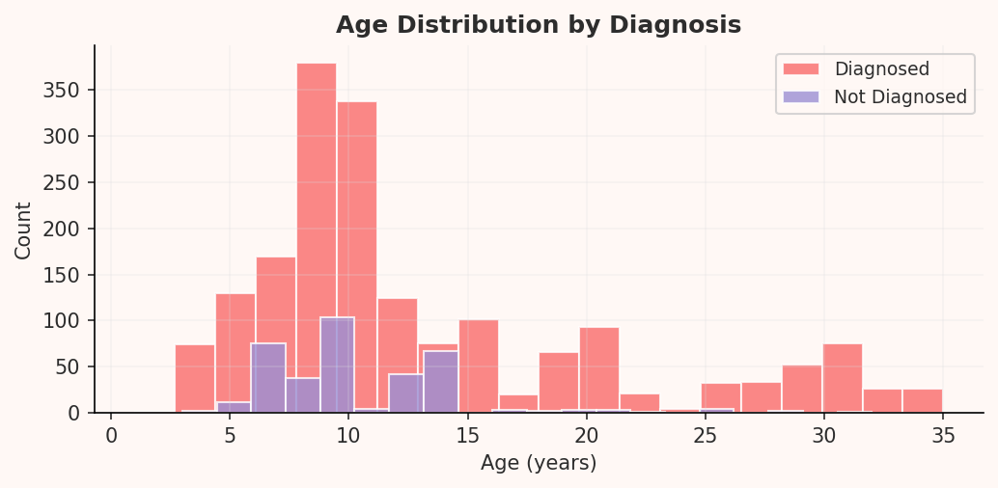
Exploratory Data Analysis — Part 1
Understanding class balance and patient age demographics
Class Distribution
Age Distribution by Diagnosis
💡 83.5% of patients are Celiac positive | Peak age group: 5–15 years (children most affected)

Slide 4
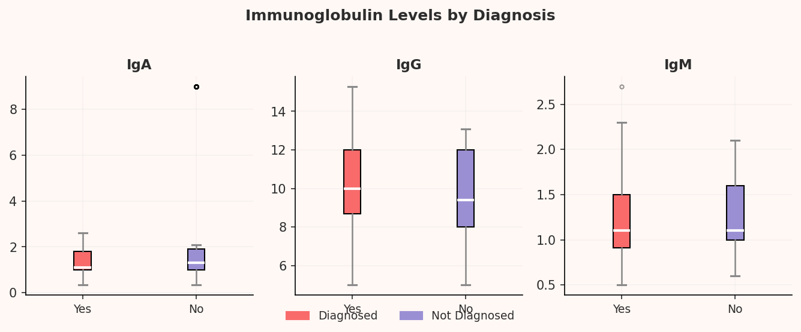
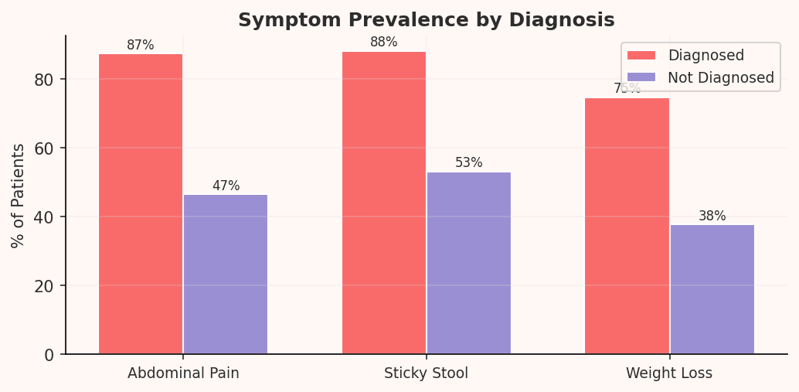
Exploratory Data Analysis — Part 2
Lab markers and clinical symptoms across diagnosed vs. non-diagnosed patients
Immunoglobulin Levels (IgA / IgG / IgM)
Symptom Prevalence by Diagnosis
💡 IgA & IgG elevated in diagnosed patients | 87% abdominal pain | 88% sticky stool in positive cases

Slide 5
Preprocessing & Hyperparameters
DATA PREPROCESSING PIPELINE
RANDOM FOREST HYPERPARAMETERS
Drop Missing Column
n_estimators = 100
01
100 decision trees in the forest. More trees = stable predictions but slower training.
Removed Diabetes Type — 418 missing values (19%). Too much to impute reliably.
max_depth = 5
Encode Categorical Data
Max tree depth = 5 levels. Prevents overfitting by limiting tree complexity.
02
Label Encoding for binary cols (Gender, Abdominal…). One-Hot for multi-class (Diarrhoea, Marsh, cd_type).
max_features = 'sqrt'
At each split, √(total features) features are considered. Keeps trees diverse.
Standardise Numerics
03
StandardScaler applied on Age, IgA, IgG, IgM — so no feature dominates due to scale differences.
criterion = 'gini'
Splits evaluated by Gini Impurity — measures how often a random sample would be misclassified.
Stratified Train-Test Split
04
class_weight = balanced
80% train / 20% test. Stratified to preserve 83/17 class ratio in both sets.
Auto-adjusts for 83% vs 17% imbalance. Penalises missing minority class (no) errors more.

Slide 6
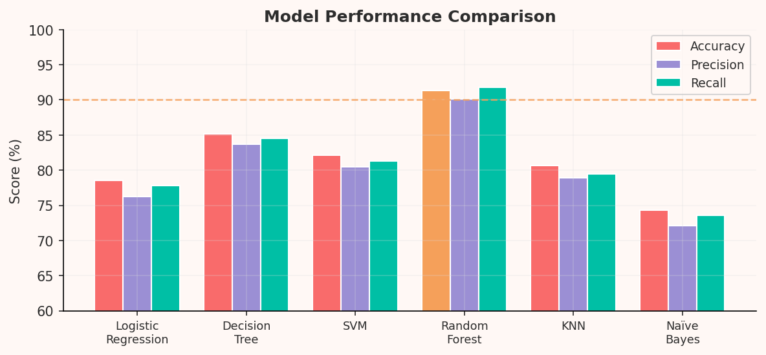
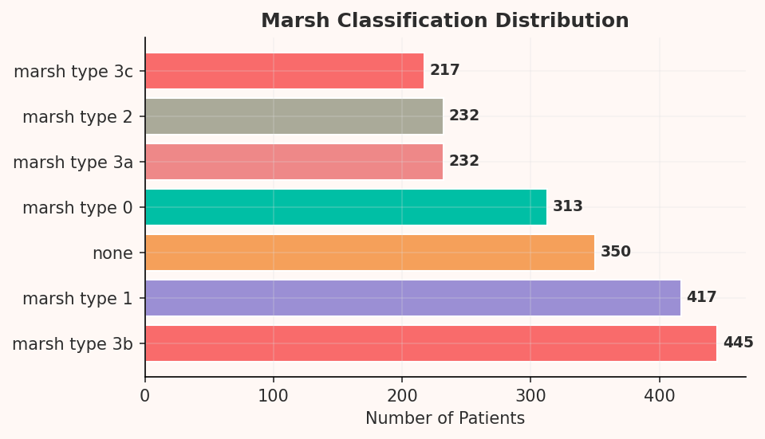
Model Comparison & Results
Model Performance Comparison (Accuracy / Precision / Recall)
Marsh Grade Distribution
Final Model Metrics
★ Random Forest achieved the best results across all metrics
Model | Accuracy | Precision | Recall | F1-Score
Logistic Regression | 78.5% | 76.2% | 77.8% | 77.0%
Decision Tree | 85.2% | 83.7% | 84.5% | 84.1%
SVM | 82.1% | 80.5% | 81.3% | 80.9%
Random Forest ★ | 91.3% | 90.1% | 91.8% | 90.9%
KNN | 80.7% | 78.9% | 79.5% | 79.2%
Naïve Bayes | 74.3% | 72.1% | 73.6% | 72.8%

Slide 7
Random Forest — How It Works
01
02
03
04
Bootstrap Sampling
Feature Randomness
Build Many Trees
Majority Voting (Bagging)
Each tree gets a random subset of training data (with replacement). This is called Bagging. Different trees see different data → reduces overfitting.
→
At every node split, only a random subset of features (√n features) is considered. Keeps trees different from each other → lowers correlation between trees.
→
Hundreds of Decision Trees are built independently, each slightly different due to data and feature randomness. Each tree is a "weak learner" on its own.
→
For a new patient, every tree independently predicts yes or no. The class with the most votes across all trees becomes the final prediction — wisdom of the crowd.
Why Random Forest for this project? → Handles class imbalance | No feature scaling needed | Provides feature importance | Robust to outliers

